Slide 1
Introduction
Android is the most used mobile OS.
It is a target to increasingly sophisticated and complex malware, and the development of better anti-malware detection and prevention methods.
We will present a number of novel non-control data attacks which will mostly take place at the kernel level.

Slide 2
Contents
`
Background
  Android's IPC
  System Start Up
  Android Security Layers
Compromising the System
Our LKM
Attacks
  Setting User Credentials
  Hooking System Calls
  Becoming the Service Manager
Conclusion

Slide 3
Background

Slide 4
Android's IPC
The binder driver is a Linux kernel module which handles most of Android's IPC.
Purpose: allowing faster IPC then sockets\pipes.
Binder allows:
  RMI
  Send\receive objects.
The driver permits communication between processes based on the following policies:
  If A talks to B → B can talk to A.
  C sends A's handle to B.
The Service Manager applies the second policy:
  holds references to all services and sets up first communications.

Slide 5
Service Manager
1
Application
Service
Service list:
Name:Handle
Name:Handle
.
.
.
onTransact(...)
Service Handle=0
4
thread pool
transact(...)
User Space
Kernel
2
3
5
Binder Driver
memory mapping

Slide 6
System Start Up
uBoot+init (the same as in Linux).
  Android differs from Linux in the script for init (called sinit).
  Init's primary operations (for our purposes):
    Linux related initialization.
    Creates the basis for all process creation (zygote).
    Creates the service manager and the system server.
The System Server is a process which runs most system services under him (Such as the Activity Manager or the Package Manager) as threads.
The Service Manager (a different process) is the first and only to register with the binder as the Service Manager.
  All services must register themselves at the service manager.

Slide 7
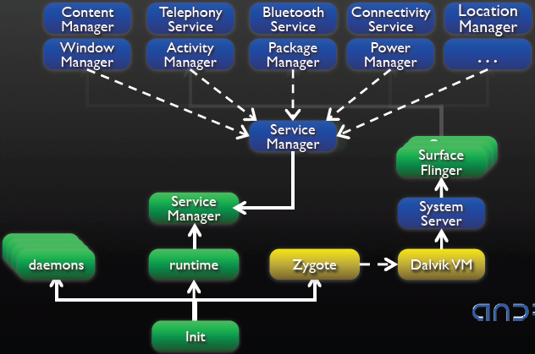

Slide 8
Security Layers
Android is based on the Linux kernel, thus inheriting its innate security features.
  Read, write and execute permissions are granted per user.
  Android service permissions (Such as GPS, INTERNET, etc) are handled via Group IDs.
  Each process is assigned a unique User ID which prevents processes from communicating with others under different UIDs.
The Binder driver does allow communications between processes, but only based on the mentioned policies.
  If two processes didn't talk to each other beforehand – they can't talk through the binder driver.
The Service Manager uses an exception in the binder driver to allow binder communications between processes. It also decides who can create services.
  Does not look at the manifest to check for permission.
Every service may impose different security checks to whomever tries to use it.
  Checks the app's manifest.

Slide 9
Compromising the System
We work under the assumptions that there exists an exploit for gaining root privileges, and that there is no malware detection for usage of the insmod API.
Steps:
  A user downloads our malicious application.
  The application gains root privileges through a known exploit.
  Our Loadable Kernel Module (LKM) is loaded using insmod.
  Using a third party application (BusyBox), a special device file is created so we can communicate with the LKM.

Slide 10
Our LKM
We use the ioctl system call to define our LKM's API.
  IOCTL_UID – Change the current process' UID.
  IOCTL_SYS_CALL – Change a selected system call into a pre-defined function within the module.
  IOCTL_CLR_CTX_MNG – Clear the saved reference and UID of the Service Manager within the Binder driver.

Slide 11
Attacks

Slide 12
Setting User Credentials (UID, GID...)
Using our LKM's IOCTL_UID call we change the applications UID to whichever UID we would like.
This enables us to mask our UID to an unsuspicious one in order to avoid routine malware detection checks, to resume root, or to act as part of the system with UID 1000.

Slide 13
Hooking System Calls
Using our LKM's IOCTL_SYS_CALL call, we replace a chosen system call with a pre-defined function we wrote within the LKM.
In order to do so we must find out where the system call table resides within the kernel. We do this when we first load the LKM.
Hooking certain system calls allows us to spy on the system, change its behavior, reduce anti-malware hooks, etc.

Slide 14
Becoming the Service Manager
First we fork a new process so it can replace the existing Service Manager.
This new process asks for all running services from the existing Service Manager and saves their references in a list.
  This is done so the system doesn't crash once we replace the Service Manager because application continuously ask for system services such as the SystemUI or the PackageManager.
We then call our LKM's IOCTL_CLR_CTX_MNG and the Binder driver's call BINDER_SET_CONTEXT_MGR to become the the official Service Manager.
As the new Service Manager we now have the ability to decide who can add new services, and if an application asks for a service for the first time, then we can decide whether to grant it access to the service or to send it a hooked version of our own.

Slide 15
Service Manager
Malicious Application
Malicious Application
Service list:
Name1:Handle1
Name2:Handle2
Name3:Handle3
.
.
.
fork()
getService()
New Service Manager
Service list:
Name1:Handle1
Name2:Handle2
Name3:Handle3
User Space
BINDER_SET_CONTEXT_MGR
Kernel
IOCTL_CLEAR_CTX_MGR
Binder Driver
Ninja
SM

Slide 16
Conclusion
We prove that we can undermine Android's and anti-malware's security by attacking from the kernel level.
In order to do so we will:
  Undermine anti-malware abilities:
    Removing system call hooks.
    Masking our UID.
  Gain control of IPC:
    Man in the middle attack between the Binder driver and specific services (ActivityManager, PackageManager, etc) (second layer).*
    Becoming the Service Manager (third layer).
  Break Android permissions (fourth layer).*
  Replace system APIs (Such as the Camera or GPS).*
Ultimately we gain complete control of the system (Without necessarily always running as root) allowing us to break or spy undetectably on the mobile phone.

